Slide 1
Sensitivity Analysis
Reddy Mikks problem

Slide 2
6th Group Members
Course:
OPERATIONAL RESEARCH AND OPTIMIZATION (MCSD1133)
Presentation to:
DR. NOR AZIZAH ALI
MOHAMMED RAZA ASFAK CHIDIMAR (MCS231004)
AYAZ RAHMAN BHUIYAN (MCS231023)
MUSAB IBNE AHMAD (MCS231017)
ISMAIL MAEEN FATEH ALLAH ALAWAMI (MCS221028)

Slide 3
Reddy Mikk Company’s Decision Variables
Variables:
X1 = tons produced daily of exterior paint
X2 = tons produced daily of interior paint
Z = total daily profit (in thousands of dollars)
Objective: Maximize, Z = 5X1 + 4X2
Constraints:
1. 6x1 + 4x2 ≤ 24 (raw material M1)
2. x1+2x2 ≤ 6 (raw material M2)
3. x2 − x1 ≤ 1
4. x2 ≤ 2

Slide 4
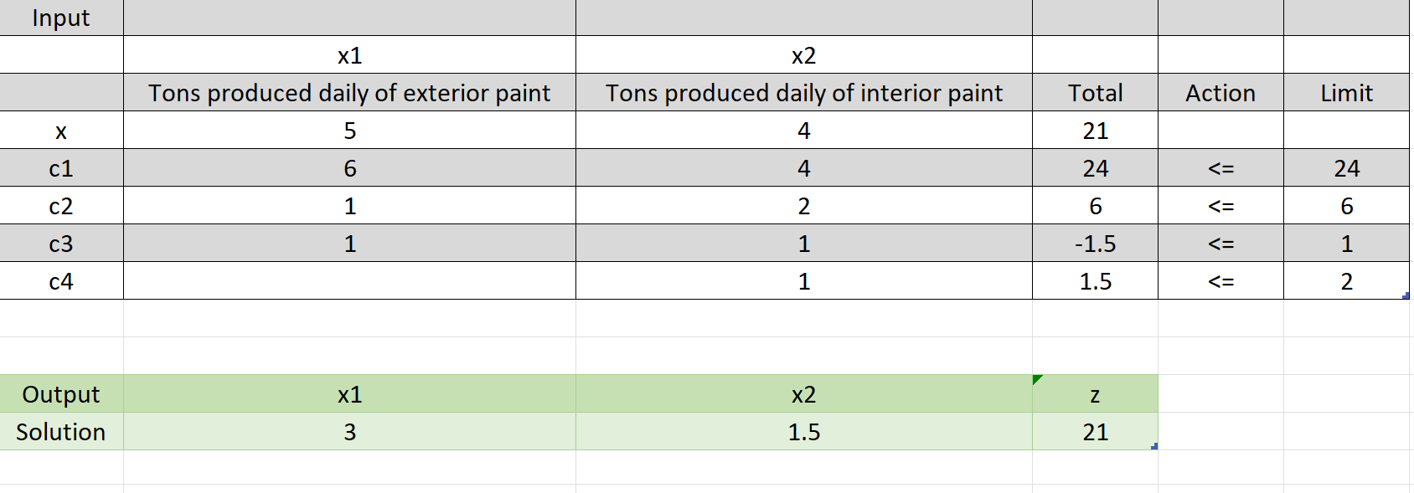
Problem Solution By
Excel Solver

Slide 5
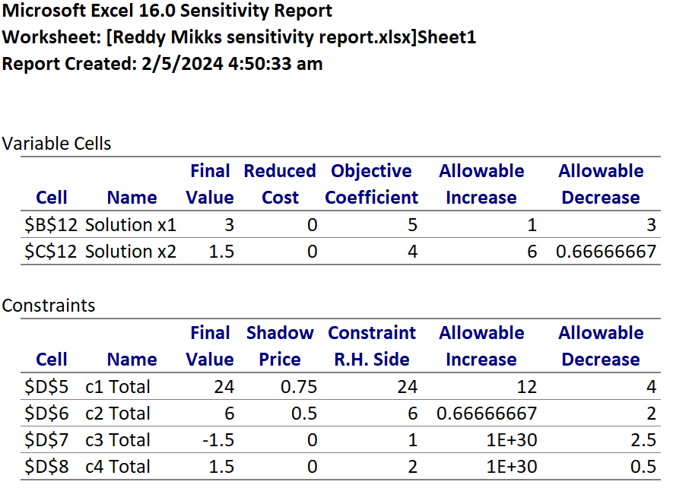
Solver’s Sensitivity report

Slide 6
Result’s to derive from Sensitivity Report
Determine the range for the ratio of the unit revenue of exterior paint to the unit revenue of interior paint.
If the revenue per ton of exterior paint remains constant at $5000 per ton, determine the maximum unit revenue of interior paint that will keep the present optimum solution unchanged.
If for marketing reasons the unit revenue of interior paint must be reduced to $2500, will the current optimum production mix change?
It is proposed that the availability of raw material 1 is increase to 30 tons. Indicate whether the changes will keep the current shadow price?
Determine the value of profit if the availability or raw material 2 is decrease by 2 tons.

Slide 7
Determine the range for the ratio of the unit revenue of exterior paint to the unit revenue of interior paint.
Milestone | Quarter
Product lunch | Q1
10,000 user milestone | Q2
Strategic partnership | Q3
Campaign launch | Q4
The ratio of the unit revenue of exterior paint (X1) to the unit revenue of interior paint (X2) can be determined from the allowable increase and decrease in the objective coefficients.
The current coefficients are 5 for X1 and 4 for X2. The allowable increase for X1 is 1 and the allowable decrease is 3. For X2, the allowable increase is 6 and the allowable decrease is approximately 0.67.
Therefore, the range for the ratio is from (Lower Bound)((5-3)/(4+6)) to (Upper Bound) ((5+1)/(4-0.67)), which simplifies to approximately 0.2 to 1.8.

Slide 8
If the revenue per ton of exterior paint remains constant at $5000 per ton, determine the maximum unit revenue of interior paint that will keep the present optimum solution unchanged.
Milestone | Quarter
Product lunch | Q1
10,000 user milestone | Q2
Strategic partnership | Q3
Campaign launch | Q4
If the revenue per ton of exterior paint remains constant at $5000 per ton, the coefficient for X1 remains at 5. With an allowable increase of 6 for X2,
the maximum unit revenue for interior paint that will keep the present optimum solution unchanged is (4 + 6 = 10), or $10,000 per ton.

Slide 9
If for marketing reasons the unit revenue of interior paint must be reduced to $2500, will the current optimum production mix change?
Milestone | Quarter
Product lunch | Q1
10,000 user milestone | Q2
Strategic partnership | Q3
Campaign launch | Q4
If the unit revenue of interior paint is reduced to $2500, this would correspond to a coefficient of 2.5 for X2. Since the allowable decrease is approximately 0.67,
reducing the unit revenue to $2500 (or a coefficient of 2.5) is outside the allowable decrease range and may change the current optimum production mix.

Slide 10
It is proposed that the availability of raw material 1 is increase to 30 tons. Indicate whether the changes will keep the current shadow price?
Milestone | Quarter
Product lunch | Q1
10,000 user milestone | Q2
Strategic partnership | Q3
Campaign launch | Q4
The proposal is to increase raw material 1 to 30 tons. Since the current usage is 24 tons and there is an allowable increase of 12 tons, this increase to 30 tons is within the allowable increase range.
Since the increase in raw material 1 is within the allowable increase, the constraint remains binding but not exceeded, meaning the optimal solution (including the shadow price of raw material 1) remains unchanged. The shadow price will continue to reflect the same value (0.75 per ton) for any increase up to 36 tons (24 + 12).

Slide 11
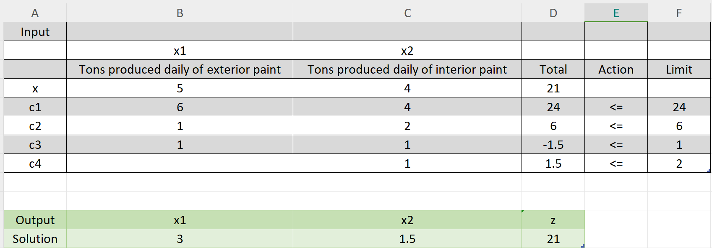
Determine the value of profit if the availability or raw material 2 is decrease by 2 tons.
Milestone | Quarter
Product lunch | Q1
10,000 user milestone | Q2
Strategic partnership | Q3
Campaign launch | Q4
To calculate the change in profit if the availability of raw material 2 is decreased by 2 tons, we need to know the shadow price for raw material 2.
Change in profit = Shadow price × Change in resource availability
Change in profit = 0.5 × (−2) = −1
Based on the sensitivity analysis, a decrease of 2 tons in raw material 2 leads to a decrease in overall profit of $1,000. Thus the overall profit will be $(21,000 - 1,000) = $20,000.

Slide 12
Thank You!

